Slide 1
Mur Ligase Open Source Project
Update, 27th April – 13th June, 2022
Adrian Lloyd, Anita Catherwood, Christopher Holes, Ciraran Duff, Becca Steventon, Laura Diaz Saez, Julie Tod, Christopher Dowson

Slide 2
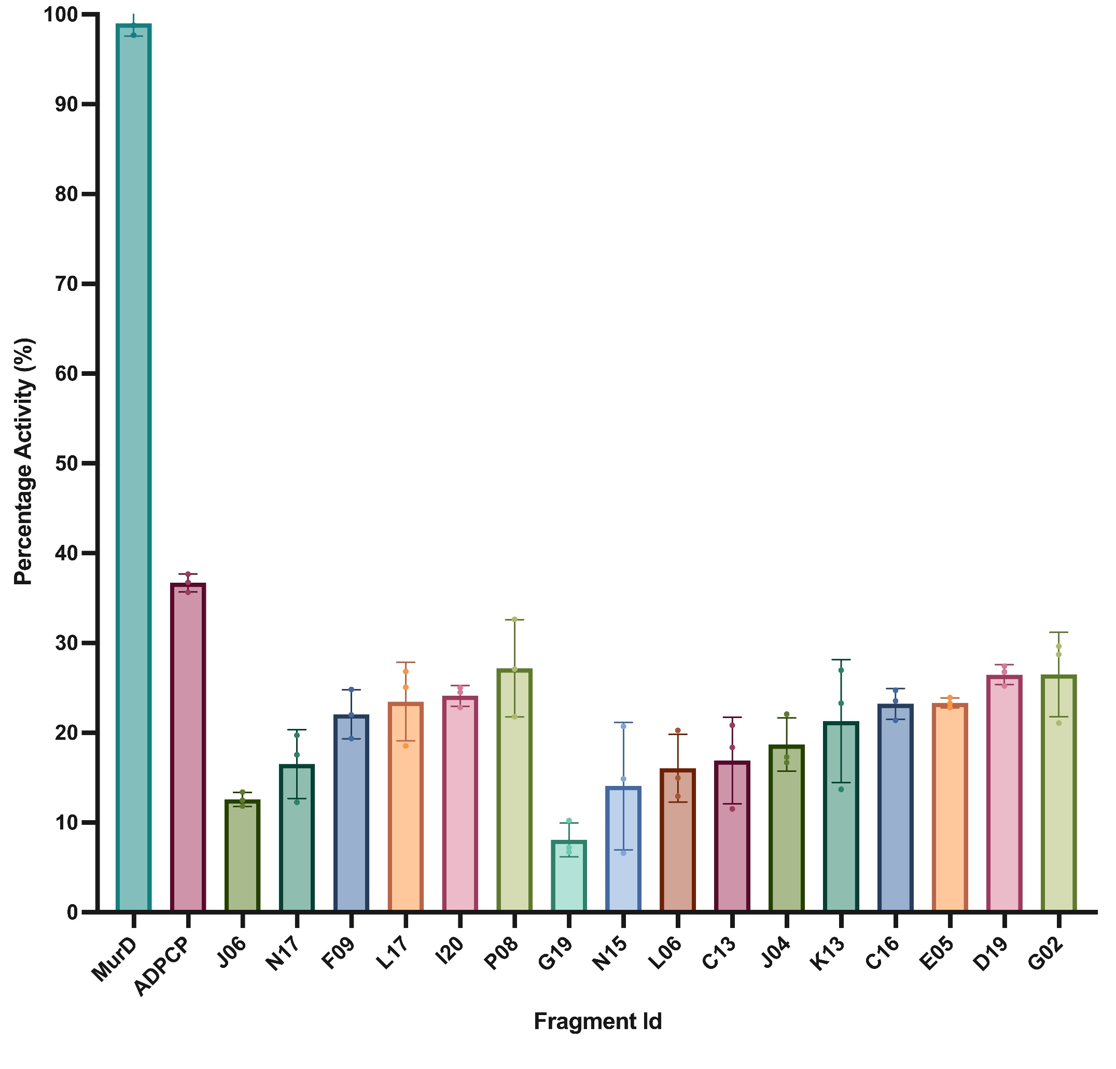
Becca’s Streptococcus agalactiae MurD Screening Data vs the Warwick Enamine Library Collection
Library selected to target ATP binding Site.
Screening at 1 mM compound was performed using a spectrophotometric with a deoxyATP substrate with a 1 mM Km.
The dATP concentration was 0.3 mM, one third of the Km for this substrate.
We investigated these hits vs P. aeruginosa MurD and MurE with a fluorescent amplex Red-based assay with 10 X the sensitivity.
This potentially allowed us to work in principle at one third of the Km of the natural ATP substrate.

Slide 3
P. aeruginosa MurD and MurE initial velocity dependencies on ATP
K_{m ATP}^{App} = 69.01 ± 6.94 μM
k_{Cat}^{App} = 554.6 ± 14.7 min⁻¹
K_{m ATP}^{App} = 59.30 ± 16.7 μM
k_{Cat}^{App} = 250.0 ± 18.4 min⁻¹
ADP release assay (Pyruvate kinase/lactate dehydrogenase coupled):
MurD: [UDP-MurNAc-Ala] = 0.1 mM, [D-glutamate] = 25 mM, [C-term. His₆-MurD] = 15.7 nM
MurE: [UDP-MurNAc-Ala-Glu] = 0.1 mM, [Diaminopimelate] = 1 mM, [C-term. His₆-MurE] = 64.3 nM

Slide 4
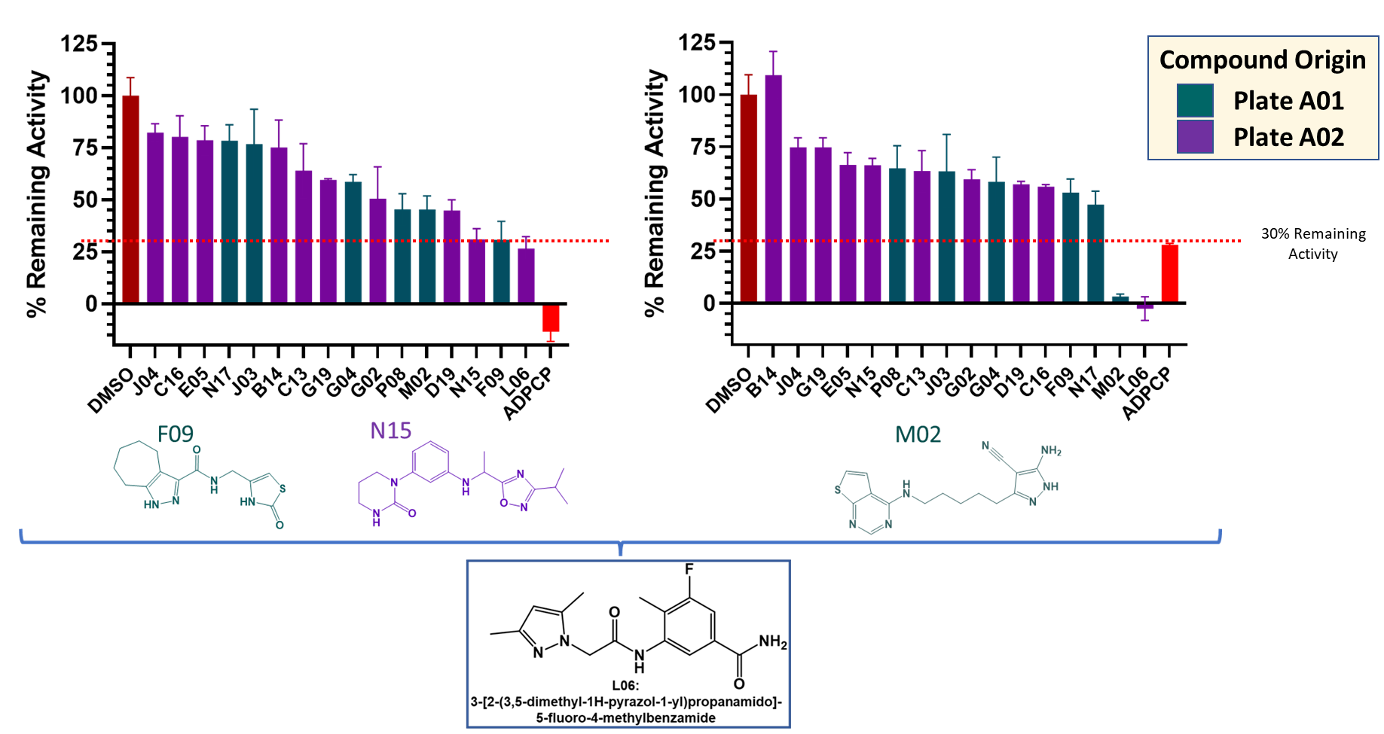
Rescreening of Enamine library S. agalactiae MurD hits against Pseudomonas aeruginosa MurD and E
P. aeruginosa MurD Screen
P. aeruginosa MurE Screen
All compounds screened at 1 mM. N=4 replicate assays.
Error bars are ± SD.
Assay was a 10 μl Amplex Red Fluorescent assay (Ex. 545 nm, Em. 585 nm)
ATP, UDP substrate and D-Glutamate/ Diaminopimelic acid concentrations were 20 μM, 0.1 mM and 25 mM / 1 mM respectively.
[MurD] = 4.4 nM, [MurE] = 513 nM
No inhibition of the detection system of the assay when assayed for such was observed.

Slide 5
Compounds unscreenable by the Amplex Red Assay at 1 mM
The following compounds, compatible with the assay Becca used for S. agalactiae gave unacceptably high backgrounds in the Amplex Red fluorescent assay. All were from Enamine plate A01: J06, N09, I20.
These compounds were re-screened in Becca’s spectrophotometric assay at 0.1 mM ATP, 0.1 mM UDP MurNAc Ala and 25 mM D-Glu using methylthioguanosine as the chromophore. Of these, J06 exerted complete inhibition of P. aeruginosa MurD in this assay.
2-(5-chlorothiophen-2-yl)-N-[3-(5-methyl-1H-1,2,4-triazol-3-yl)phenyl]acetamide
These compounds will be re-tested in this format vs P. aeruginosa MurE.
NOTE, at 0.5 mM and below, J06 is compatible with the Amplex Red assay.

Slide 6
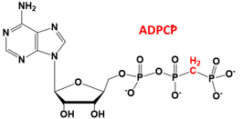
Characterization of Enamine library P. aeruginosa MurD hit F09 (Plate A01)
F09: N-[(2-oxo-2,3-dihydro-1,3-thiazol-4-yl)methyl]-1H,4H,5H,6H,7H,8H-cyclohepta[c]pyrazole-3-carboxamide
IC₅₀ = 129.4 ± 22.8 μM
Assuming competition with ATP binding site, Cheng Prussoff Eq^{n} suggests a Ki of 100.3 μM.
IC₅₀ = 24.9 ± 5.7 μM
Assuming competition with ATP binding site, Cheng Prussoff Eq^{n} suggests a Ki of 19.3 μM.
N=4 replicate assays. Error bars are SD.
ATP, UDP MurNAc-Ala and D-glutamate concentrations were 20 μM, 0.1 mM and 25 mM respectively.
[MurD] = 4.4 nM. Assay was a 10 μl Amplex Red Fluorescent assay (Ex. 545 nm, Em. 585 nm)
Data could be interpreted to suggest F09 binds 100.3/19.3 = 5.2 –fold less tightly than ADPCP.

Slide 7
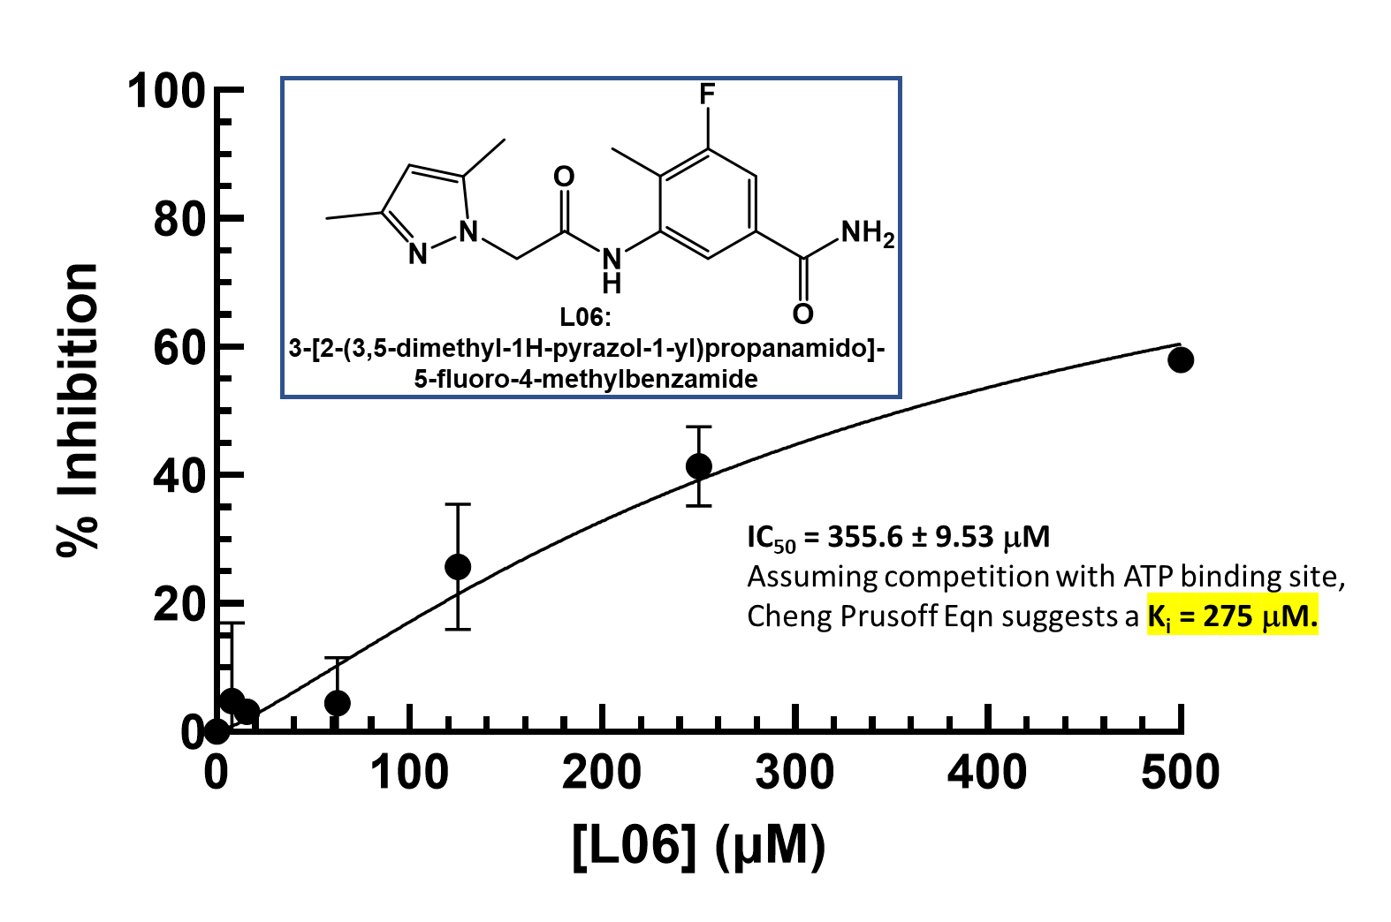
Characterization of Enamine library P. aeruginosa MurD hit L06 (Plate A02)
IC₅₀ = 24.9 ± 5.7 μM
Assuming competition with ATP binding site, Cheng Prussoff Eqn suggests a Ki of 19.3 μM.
N=4 replicate assays. Error bars are SD.
ATP, UDP MurNAc-Ala-Glu and D-glutamate concentrations were 20 μM, 0.1 mM and 25 mM respectively.
[MurD] = 4.4 nM. Assay was a 10 μl Amplex Red Fluorescent assay (Ex. 545 nm, Em. 585 nm)
Data could be interpreted to suggest L06 binds 275/19.3 = 14.3 –fold less tightly than ADPCP.

Slide 8
Characterization of Enamine library P. aeruginosa MurD hit J06 (Plate A01)
J06: 2-(5-chlorothiophen-2-yl)-N-[3-(5-methyl-1H-1,2,4-triazol-3-yl)phenyl]acetamide
IC₅₀ = 21.38 ± 2.22 μM
Assuming competition with ATP binding site, Cheng Prussoff Eq^{n} suggests a Ki of 16.6 μM.
IC₅₀ = 24.9 ± 5.7 μM
Assuming competition with ATP binding site, Cheng Prussoff Eq^{n} suggests a Ki of 19.3 μM.
N=4 replicate assays. Error bars are SD.
ATP, UDP MurNAc-Ala and D-glutamate concentrations were 20 μM, 0.1 mM and 25 mM respectively.
[MurD] = 4.4 nM. Assay was a 10 μl Amplex Red Fluorescent assay (Ex. 545 nm, Em. 585 nm)
Data could be interpreted to suggest J06 binds 19.3/16.6 = 1.1 –fold more tightly than ADPCP.

Slide 9
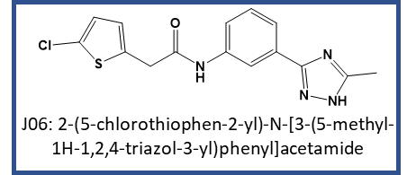
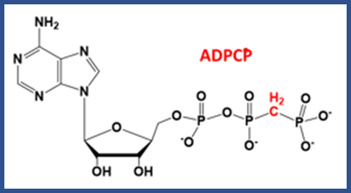
Characterization of Enamine library P. aeruginosa MurE hit J06 (Plate A01)
IC₅₀ = 16.62 ± 1.02 μM
Assuming competition with ATP binding site, Cheng Prussoff Eq^{n} suggests a Ki of 12.4 μM.
IC₅₀ = 2.34 ± 0.3 μM
Assuming competition with ATP binding site, Cheng Prussoff Eq^{n} suggests a Ki of 0.87 μM.
N=4 replicate assays. Error bars are SD.
ATP, UDP MurNAc-Ala-Glu and diaminopimelic acid (racemic mixture) concentrations were 20 μM, 0.1 mM and 16 mM respectively.
[MurE] = 2.17 nM. Assay was a 10 μl Amplex Red Fluorescent assay (Ex. 545 nm, Em. 585 nm)
Data could be interpreted to suggest J06 binds 19.3/16.6 = 1.1 –fold more tightly than ADPCP.

Slide 10
Comparison of the inhibition of P. aeruginosa MurD and MurE by J06 (Plate A01)
Mur Ligase | IC₅₀ (μM) | K_{i} (μM) (Cheng Prusoff)
P. aeruginosa MurD | 21.38 ± 2.22 | 16.6
P. aeruginosa MurE | 16.62 ± 1.02 | 12.4

Slide 11
Attempted Characterization of Enamine library P. aeruginosa MurE hit L06 (Plate A02)
IC₅₀ ~ 792 ± 110.7 μM
Assuming competition with ATP binding site, Cheng Prussoff Eq^{n} suggests a Ki of 592 μM.
IC₅₀ = 2.34 ± 0.3 μM
Assuming competition with ATP binding site, Cheng Prussoff Eq^{n} suggests a Ki of 0.87 μM.
N=4 replicate assays. Error bars are SD.
ATP, UDP MurNAc-Ala-Glu and diaminopimelic acid (racemic mixture) concentrations were 20 μM, 0.1 mM and 16 mM respectively.
[MurE] = 2.17 nM. Assay was a 10 μl Amplex Red Fluorescent assay (Ex. 545 nm, Em. 585 nm)
Data could be interpreted to suggest L06 binds 592/0.87 = 680 –fold less tightly than ADPCP
Requires repetition, not least because IC₅₀ falls beyond the L06 concentration range of the data and in this experiment is less potent than suggested by the original observation of potency

Slide 12
Characterization of Enamine library P. aeruginosa MurE hit M02 (Plate A01)
IC₅₀ = 103.9 ± 11.03 μM
Assuming competition with ATP binding site, Cheng Prussoff Eq^{n} suggests a Ki of 77.6 μM.
IC₅₀ = 2.34 ± 0.3 μM
Assuming competition with ATP binding site, Cheng Prussoff Eq^{n} suggests a Ki of 0.87 μM.
ATP, UDP MurNAc-Ala-Glu and diaminopimelic acid (racemic mixture) concentrations were 20 μM, 0.1 mM and 16 mM respectively.
[MurE] = 2.17 nM. Assay was a 10 μl Amplex Red Fluorescent assay (Ex. 545 nm, Em. 585 nm)
Data could be interpreted to suggest M02 binds 77.06/0.87 = 88 –fold less tightly than ADPCP.

Slide 13
Characterization of ATP dependence of P. aeruginosa MurC: Substrate Inhibition
Michaelis Menten
Substrate Inhibition
K_{m}^{APP} = 162 ± 28.4 μM
k_{cat}^{App =} 124 ± 8.1 min⁻¹
K_{m}^{APP} = 222.6 ± 121.2 μM
k_{cat}^{App} = 153.1 ± 56.1 min⁻¹
K_{i} ^{APP} = 2293 ± 4291 μM
[MurC] = 122 nM, [UDP MurNAc] = 0.125 mM, [L-Alanine] = 0.1 mM
More than one binding mode for ATP, the second of which is inhibitory: Possible competition with the uridine nucleotide binding site?

Slide 14
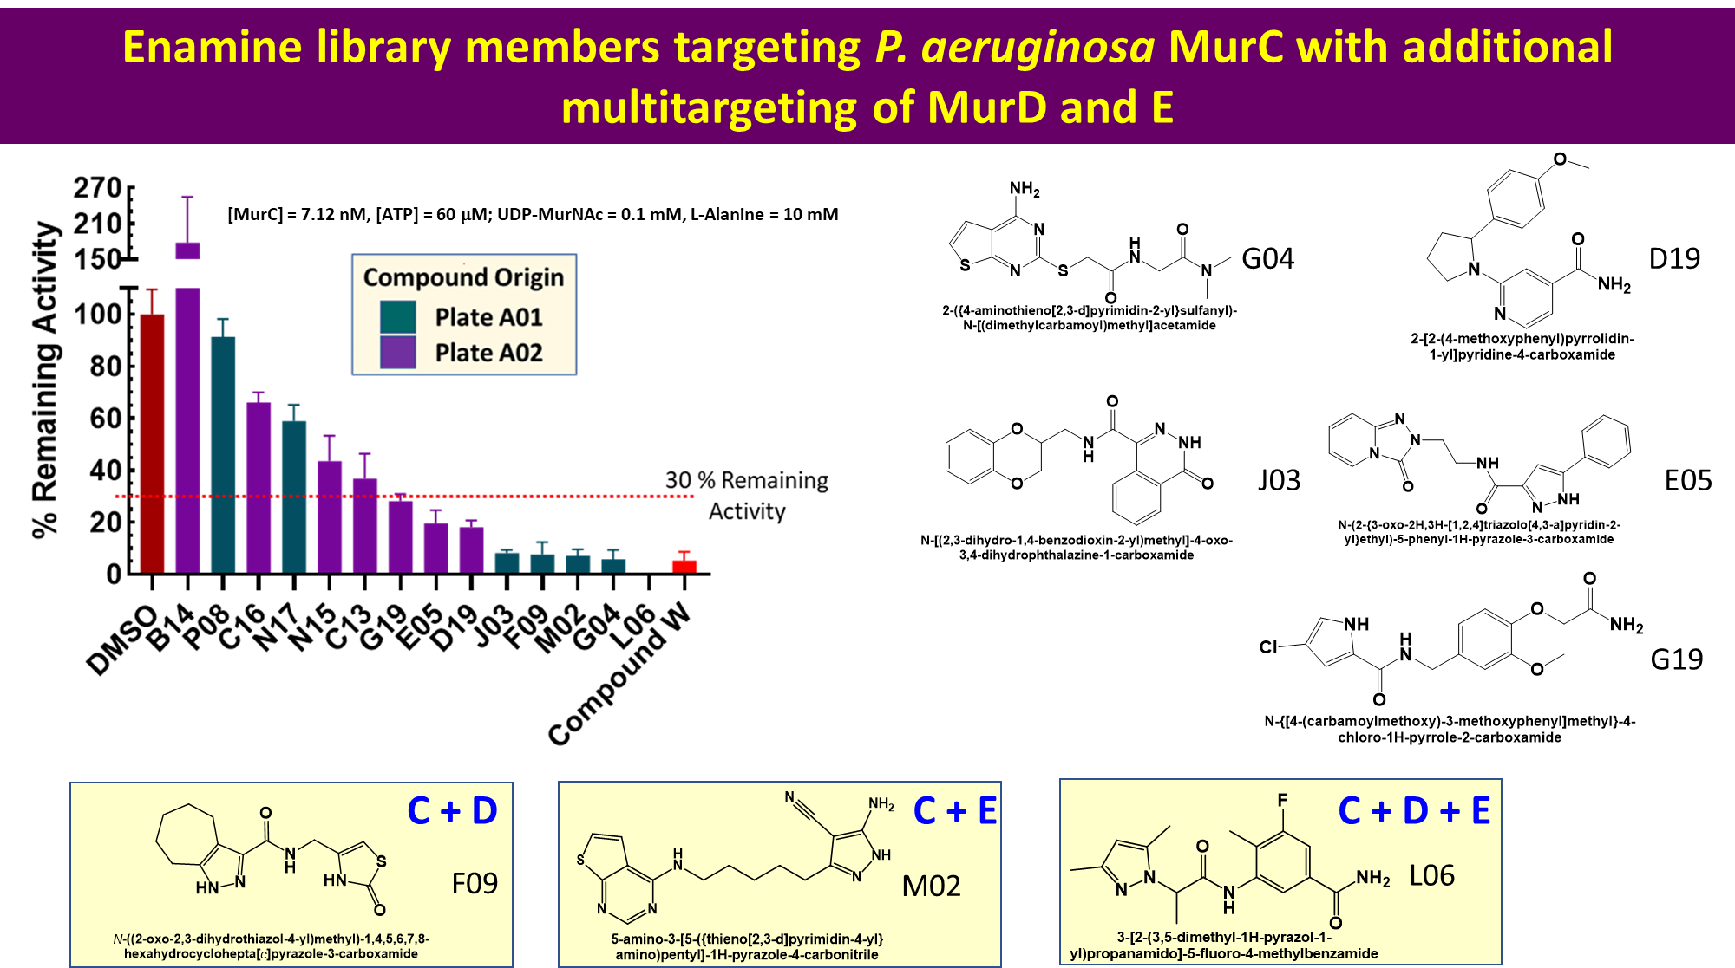
[Compound] = 1mM

Slide 15
Characterization of Enamine library hits with E. coli MurD and MurE
E. coli MurE ATP Dependence
E. coli MurD ATP Dependence
K_{m}^{App} = 38.97 ± 5.97 μM
K_{m}^{App} = 148.8 ± 31.88 μM
Note, like P. aeruginosa MurC, kinetics of E. coli MurD characterised by sustrate inhibition with respect to ATP; again, suggestive of an additional site of interaction by ATP.
E. coli MurD ATP Dependence
Extended Range
Not easily fit to simple substrate inhibition model
All assays, UDP MurNAc substrate = 0.125 mM.
meso-DAP (MurE) = 0.2 mM, D-Glu (MurD) = 5 mM

Slide 16
Inhibition of E. coli MurD and E by Compounds J06 and L06
E. coli MurE
100 μM ATP IC₅₀ = 0.14 ± 0.07 mM
20 μM ATP IC₅₀ = 13.53 ± 3.36 μM
20 μM ATP IC₅₀ = 0.16 ± 0.02 mM
100 μM ATP IC₅₀ = 41.09 ± 26.21 μM
E. coli MurD
20 μM ATP IC₅₀ = 0.048 ± 0.27 mM
20 μM ATP IC₅₀ = 0.74 ± 0.03 μM
100 μM ATP IC₅₀ = 2.48 ± 0.07 μM
100 μM ATP IC₅₀ = 0.379 ± 0.35 mM

Slide 17
Inhibition of E. coli MurE with Ap4A –targeting two (U and A) nucleotide binding sites?
?
IC₅₀ = 1.1 ± 0.06 mM
Commercially available

Slide 18
Compound J06: Enamine plate A01-3).
J06 MIC data were obtained vs
Streptococcus agalactiae 13813; MIC > 2.5 mM (> 832 μg/ml)
E. coli 25922 (WT): MIC > 2.5 mM (> 832 μg/ml)
E.coli TolC: MIC = 0.312 mM (104 μg/ml)
P.aeruginosa PA01 (WT) MIC > 2.5 mM (> 832 μg/ml)
P.aeruginosa TolC MIC > 2.5 mM (> 832 μg/ml).
Ampicillin controls:
S. agalactiae 13813 MIC < 0.0716 μM (< 0.025 μg/ml
P. aeruginosa WT and TolC both > 73 μM (256 μg/ml)
E. coli Wild type MIC = 7.16 μM (2.5 μg/ml)
E. coli TolC MIC < 0.0716 μM (< 0.025 μg/ml).
DMSO controls were also run. No impact on growth was observed at the lowest dilution of DMSO (final conc of 1%)
The MIC cultures were replated to determine if the impact of J06 was either bacteriostatic or bacteriocidal on the E. coli TolC experiment. The experiment showed that the MBC (minimal bacteriocidal concentration) was > 2.5 mM and therefore J06 was active in E. coli TolC as a bacteriostatic agent. The data suggest J06 has no impact on the growth of wild type E. coli, unless TolC, an export pump is inactivated. Similarly, there is no impact on either P. aeruginosa (either with or without TolC) or S. agalactiae. Given the likely ATP binding site directed nature of J06, what could also be at play here are the cytoplasmic concentrations of ATP in the strains under the conditions tested (Wild type E. coli cytoplasmic [ATP] estimates are in the 1 to 10 mM range in the literature).
J06 has an MIC vs a permeablised strain (TolC⁻) strain of E. coli
L06 has no impact as an antimicrobial at up to 2.5 mM

